Slide 1


Introduction to Computer Science
Reichman University
Lecture 2-2
Conditional and Iterative Processing
Part II
Notes:
1

Slide 2
Lecture plan
Conditional logic:
if
switch
Strings
Iterative logic:
while
for
do ... while

Slide 3
The FOR statement
Example 1: Print something 100 times
public class ForDemo {
public static void main(String[] args) {
Algorithm
for count = 0 , ..., 99
print (“I will not argue...”)
% java ForDemo
I will not argue ...
I will not argue ...
I will not argue ...
I will not argue ...
I will not argue ...
I will not argue ...
I will not argue ...
...

Slide 4
The FOR statement
Example 1: Print something 100 times
public class ForDemo {
public static void main(String[] args) {
for (int count = 0; count < 100; count++) {
System.out.println("I will not argue ...");
}
}
}
Algorithm
for count = 0 , ..., 99
print (“I will not argue...”)
% java ForDemo
I will not argue ...
I will not argue ...
I will not argue ...
I will not argue ...
I will not argue ...
I will not argue ...
I will not argue ...
...

Slide 5
The FOR statement
Example 2: Print the integers 0, 1, ..., 99
Algorithm
for i = 0 , ..., 99
print (i)
// Prints 0, 1, ..., 99
0
1
2
3
4
5
6
7
...

Slide 6
The FOR statement
Example 2: Print the integers 0, 1, ..., 99
Algorithm
for i = 0 , ..., 99
print (i)
// Prints 0, 1, ..., 99
for (int i = 0; i < 100; i++) {
System.out.println(i);
}
0
1
2
3
4
5
6
7
...

Slide 7
The FOR statement
Example 3: Print powers of two : 2⁰, 2¹, 2², 2³, … , 2^{N}
Algorithm
for i = 0 , ..., N
print(i , Math.power(2 , i))
% java PowersOfTwo 6
0 1
1 2
2 4
3 8
4 16
5 32
6 64

Slide 8
The FOR statement
Example 3: Print powers of two : 2⁰, 2¹, 2², 2³, … , 2^{N}
Algorithm
for i = 0 , ..., N
print(i , Math.power(2 , i))
for implementation
// Prints the powers of 2 up to 2^{N}
for (int i = 0; i <= N; i++) {
System.out.println(i + " " + Math.pow(2,i);
}
Inefficient!
Do you see why?
% java PowersOfTwo 6
0 1
1 2
2 4
3 8
4 16
5 32
6 64

Slide 9
The FOR statement
Example 3: Print powers of two : 2⁰, 2¹, 2², 2³, … , 2^{N}
Algorithm
v = 1
for i = 0 , ..., N
print(i , v)
v = 2 * v
for implementation
// Prints the powers of 2 up to 2^{N}
% java PowersOfTwo 6
0 1
1 2
2 4
3 8
4 16
5 32
6 64

Slide 10
The FOR statement
Example 3: Print powers of two : 2⁰, 2¹, 2², 2³, … , 2^{N}
Algorithm
v = 1
for i = 0 , ..., N
print(i , v)
v = 2 * v
for implementation
// Prints the powers of 2 up to 2^{N}
int v = 1;
for (int i = 0; i <= N; i++) {
System.out.println(i + " " + v);
v = 2 * v;
}
while implementation (equivalent)
// Prints the powers of 2 up to 2^{N}
int v = 1;
int i = 0;
while (i <= N) {
System.out.println(i + " " + v);
i = i + 1;
v = 2 * v;
}
% java PowersOfTwo 6
0 1
1 2
2 4
3 8
4 16
5 32
6 64
Best practice: A for-loop is typically preferred over a while-loop.

Slide 11
The FOR statement
for ( int i = 0; i <= N; i++ ) {
System.out.println(i + " " + v);
v = 2 * v;
}

Slide 12
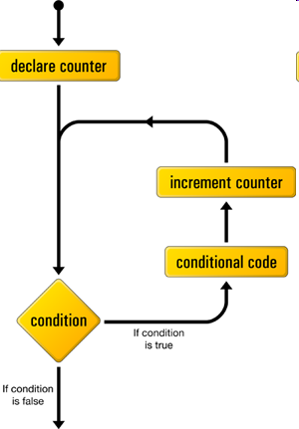

The FOR statement
declares a counter
checks condition
increments the counter
for ( int i = 0; i <= N; i++ ) {
System.out.println(i + " " + v);
v = 2 * v;
}
conditional code
true
false

Slide 13
The FOR statement
// Computes sum = 1 + 2 + 3 + ... + N
Compare to:

Slide 14
The FOR statement
// Computes sum = 1 + 2 + 3 + ... + N
int sum = 0;
for (int i = 1; i <= N; i++) {
sum += i; // shorthand of sum = sum + i
}
// Computes N!= 1 * 2 * 3 * ... * N
Compare to:

Slide 15
The FOR statement
// Computes sum = 1 + 2 + 3 + ... + N
int sum = 0;
for (int i = 1; i <= N; i++) {
sum += i; // shorthand of sum = sum + i
}
// Computes N!= 1 * 2 * 3 * ... * N
int factorial = 1;
for (int i = 1; i <= N; i++) {
factorial *= i; // shorthand of factorial = factorial * i
}
// Computes sum = 1 + 1/2 + 1/3 + 1/4 + ... + 1/N
Compare to:

Slide 16
The FOR statement
// Computes sum = 1 + 2 + 3 + ... + N
int sum = 0;
for (int i = 1; i <= N; i++) {
sum += i;
}
// Computes N!= 1 * 2 * 3 * ... * N
int factorial = 1;
for (int i = 1; i <= N; i++) {
factorial *= i;
}
// Computes sum = 1 + 1/2 + 1/3 + 1/4 + ... + 1/N
double sum = 0.0;
for (int i = 1; i <= N; i++) {
sum = sum + 1.0 / i;
}
Compare to:

Slide 17
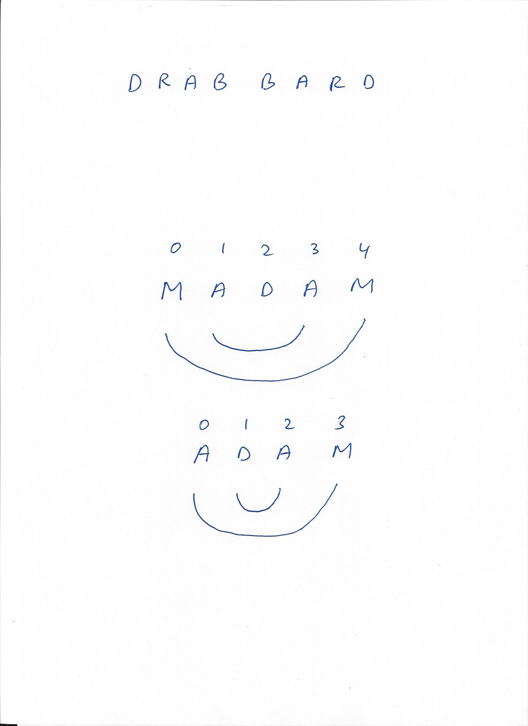
Palindrome revisited, using FOR
public class Palindrome1 {
public static void main(String[] args) {
// Gets the string from the user:
String s = args[0];
Algorithm
(string length = N)
Compare letters:
0 and 9
1 and 8
2 and 7
...
i and N – 1 – i
Stop when i = N / 2
% java Palindrome1 adam
adam is not a palindrome
% java Palindrome1 madam
madam is a palindrome

Slide 18
Palindrome revisited, using FOR
public class Palindrome1 {
public static void main(String[] args) {
// Gets the string from the user:
String s = args[0];
boolean isPalindrome = true;
int N = s.length();
int mid = N / 2;
for (int i = 0; i < mid; i++) {
if (s.charAt(i) != s.charAt(N – 1 – i)) {
isPalindrome = false;
break; // Can be used to exit any for / while loop
}
}
if (isPalindrome)
System.out.println(s + " is a palindrome");
else
System.out.println(s + " is not a palindrome");
}
}
Algorithm
(string length = N)
Compare letters:
0 and 9
1 and 8
2 and 7
...
i and N – 1 – i
Stop when i = N / 2
% java Palindrome1 adam
adam is not a palindrome
% java Palindrome1 madam
madam is a palindrome

Slide 19
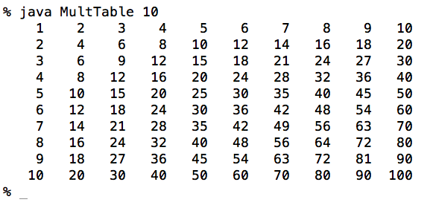
Nested for
Task: Print a multiplication table of size N
Algorithm
public class MultTable {
public static void main(String[] args) {
int N = Integer.parseInt(args[0]);
for i = 1 , ..., N
for j = 1 , ..., N
print (i * j)
newline

Slide 20
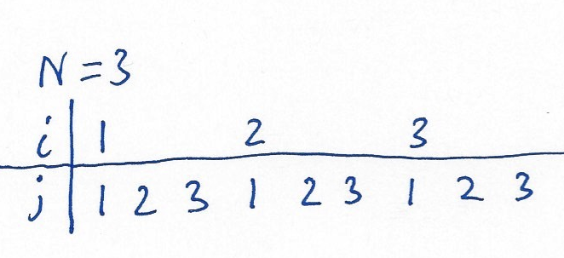
Nested for
Task: Print a multiplication table of size N
Algorithm
public class MultTable {
public static void main(String[] args) {
int N = Integer.parseInt(args[0]);
for (int i = 1 ; i <= N ; i++) {
for (int j = 1 ; j <= N ; j++) {
System.out.print(" " + i * j);
}
System.out.println();
}
}
}
for i = 1 , ..., N
for j = 1 , ..., N
print (i * j)
newline

Slide 21
Lecture plan
Conditional logic:
if
switch
Strings
Iterative logic:
while
for
do ... while

Slide 22
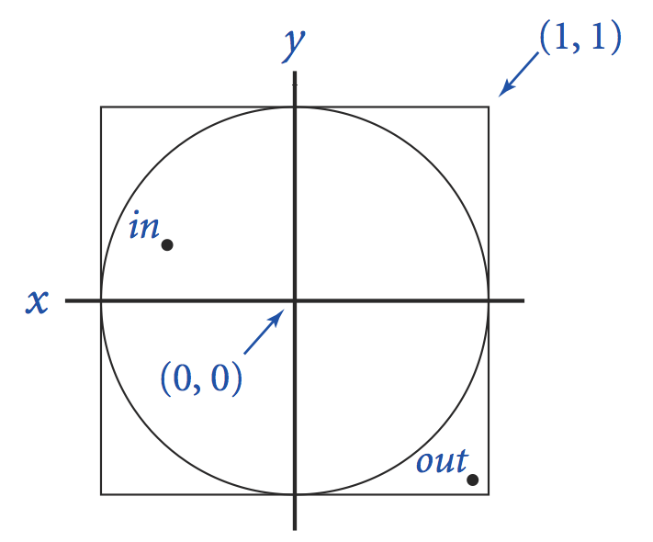
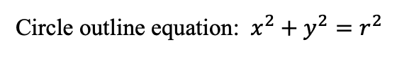

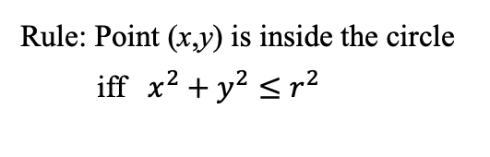
Do-While (by example)
(1,1)
Task: Given: A unit circle (r = 1) centered at (0 , 0);
Generate a random point (x , y) inside the circle.
Algorithm (rejection method):
Generate a random point inside the unit square;
If the point is inside the unit circle, we’re done;
Else, keep trying.
$$1$$
(-1,-1)
do {
// Generates random x and y, each in [-1,1(
x = 2.0 * Math.random() – 1.0;
y = 2.0 * Math.random() – 1.0;
} while (x * x + y * y > 1.0);
// (x,y) is inside the circle
...
Geometry:
Circle outline equation: ${ x}^{2} + y^{2}=r^{2}$
Rule: Point (x,y) is inside the circle iff ${ x}^{2} + y^{2}≤r^{2}$
Technical observation
A while loop executes 0 or more iterations;
A do-while loop executes 1 or more iterations.

Slide 23
Introduction to Computer Science
Shimon Schocken
IDC Herzliya
Lecture 2-2
Numeral Systems
Notes:
23

Slide 24
Numeral systems
Twenty seven goats
...
Unary:

Slide 25
Numeral systems
Seven thousands and fifty three goats
...
Unary:
...
Oy…

Slide 26
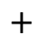
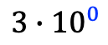
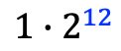
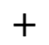
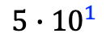
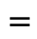

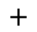
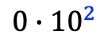
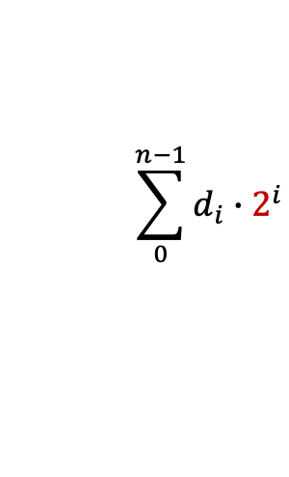
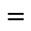
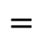
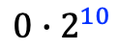
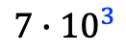
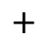
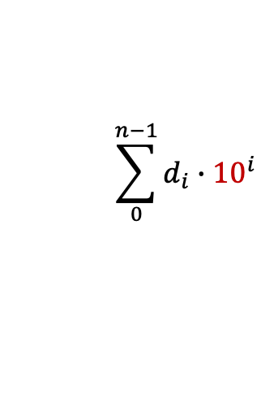
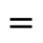
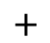
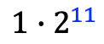
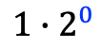
Numeral systems
Seven thousands and fifty three goats
...
3
2
1
0
7 0 5 3
human friendly
$$\sum_{0}^{n−1}{d_{i}}∙{10}^{i}$$
$$=$$
$$7∙{10}^{3}$$
$$+$$
$$0∙{10}^{2}$$
$$+$$
$$5∙{10}^{1}$$
$$+$$
$$3∙{10}^{0}$$
$$=$$
7053
(n is the number of digits in the numeral, d_{i} is the digit in position i)
12
11
10
. . .
3
2
1
0
computer friendly
1 1 0 1 1 1 0 0 0 1 1 0 1_{bin}
. . .
$$\sum_{0}^{n−1}{d_{i}}∙2^{i}$$
$$=$$
$$1∙2^{12}$$
$$+$$
$$1∙2^{11}$$
$$+$$
$$0∙2^{10}$$
$$+$$
$$…$$
$$+$$
$$1∙2^{0}$$
$$=$$
7053

Slide 27
Numeral systems
Decimal
Binary
0
1
2
3
0
1
1 0
1 1

Slide 28
Numeral systems
Decimal
Binary
0
1
2
3
4
5
6
7
0
1
1 0
1 1
1 0 0
1 0 1
1 1 0
1 1 1

Slide 29
Numeral systems
Decimal
Binary
0
1
2
3
4
5
6
7
8
9
10
11
12
13
14
15
...
0
1
1 0
1 1
1 0 0
1 0 1
1 1 0
1 1 1
1 0 0 0
1 0 0 1
1 0 1 0
1 0 1 1
1 1 0 0
1 1 0 1
1 1 1 0
1 1 1 1
...
Observations
Decimal system: Nothing special about it;
Binary system: Minimal, elegant, efficient.
Inside computers, everything is represented in binary.
Because humans prefer using the decimal system, computers have to work hard to convert …
Binary → decimal (when showing numbers to humans)
Decimal → binary (when getting numbers from humans).

Slide 30
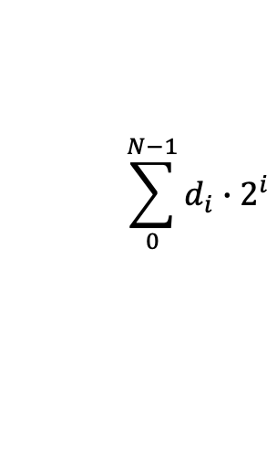
Binary → Decimal
$${10011}_{bin}=1∙2^{4}+0∙2^{3}+0∙2^{2}+1∙2^{1}+1∙2^{0}={19}_{dec}$$
A sequence of characters, representing 0’s and 1’s.
Algorithm
Input: a string of N 0 and 1 characters
Output: an integer, representing the decimal value coded by the input
Use a loop to iterate through the input string and compute the decimal value using the formula:
% java BinToDec 10011
19
% java BinToDec 10000
16
% java BinToDec 101
5
% java BinToDec 1100110101110
6574
% java BinToDec 10
2
% java BinToDec 1
1
% java BinToDec 0
0
$$\sum_{0}^{N−1}{d_{i}}∙2^{i}$$

Slide 31
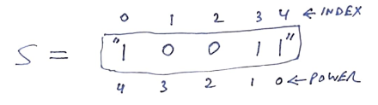
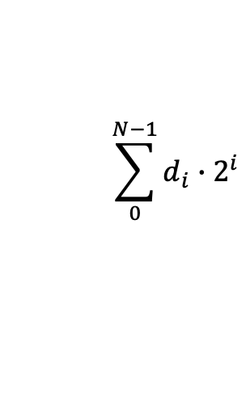
Binary → Decimal
$${10011}_{bin}=1∙2^{4}+0∙2^{3}+0∙2^{2}+1∙2^{1}+1∙2^{0}={19}_{dec}$$
public class BinToDec {
public static void main (String[] args) {
String s = args[0];
int N = s.length();
A sequence of characters, representing 0’s and 1’s.
% java BinToDec 10011
19
% java BinToDec 10000
16
% java BinToDec 101
5
% java BinToDec 1100110101110
6574
% java BinToDec 10
2
% java BinToDec 1
1
% java BinToDec 0
0
$$\sum_{0}^{N−1}{d_{i}}∙2^{i}$$

Slide 32
Binary → Decimal
$${10011}_{bin}=1∙2^{4}+0∙2^{3}+0∙2^{2}+1∙2^{1}+1∙2^{0}={19}_{dec}$$
public class BinToDec {
public static void main (String[] args) {
String s = args[0];
int N = s.length();
int val = 0;
int power;
for (int i = 0; i < N; i++) {
if (s.charAt(i) == '1') {
power = N - i - 1;
val = val + (int) Math.pow(2, power);
}
}
System.out.println(val);
}
}
A sequence of characters, representing 0’s and 1’s.
% java BinToDec 10011
19
% java BinToDec 10000
16
% java BinToDec 101
5
% java BinToDec 1100110101110
6574
% java BinToDec 10
2
% java BinToDec 1
1
% java BinToDec 0
0
Inefficient!
$$\sum_{0}^{N−1}{d_{i}}∙2^{i}$$

Slide 33
Binary → Decimal
$${10011}_{bin}=1∙2^{4}+0∙2^{3}+0∙2^{2}+1∙2^{1}+1∙2^{0}={19}_{dec}$$
public class BinToDec {
public static void main (String[] args) {
String s = args[0];
int N = s.length();
int val = 0;
int power;
for (int i = 0; i < N; i++) {
if (s.charAt(i) == '1') {
power = N - i - 1;
val = val + (int) Math.pow(2, power);
}
}
System.out.println(val);
}
}
A sequence of characters, representing 0’s and 1’s.
% java BinToDec 10011
19
% java BinToDec 10000
16
% java BinToDec 101
5
% java BinToDec 1100110101110
6574
% java BinToDec 10
2
% java BinToDec 1
1
% java BinToDec 0
0
Inefficient!
Self-study exercise
Simulate using a trace table
Find another algorithm that uses previously computed results without using Math.pow().

Slide 34
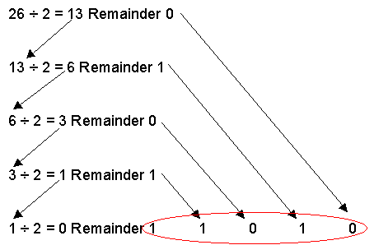
Decimal → Binary
Algorithm
Input: an integer value;
Output: a string of 0 and 1 characters.
Use a loop to iterate through the integer value and extract a binary digit in each iteration.
26_{dec} = ?_{bin}
public class DecToBin {
public static void main (String[] args) {
int x = Integer.parseInt(args[0]);
String s = "";
while (x > 0) {
if ((x % 2) == 0) {
s = "0" + s;
}
else {
s = "1" + s;
}
x = x / 2; // integer division
}
System.out.println(s);
}
}
% java DecToBin 26
11010
% java DecToBin 16
10000
% java DecToBin 5
101
% java DecToBin 723462347
101011000111110010100011001011
% java DecToBin 2
10
% java DecToBin 1
1
% java DecToBin 0
%
Bug: the input 0 is not processed correctly
Lesson: always test edge cases!

Slide 35
Binary representation: Much more to learn (in other CS courses)
How to use binary numbers to represent:
Nonnegative integers (done)
Negative integers (“Two’s Complement method”)
Real numbers (“Floating Point method”)
How to use binary operations to efficiently implement:
Addition
Subtraction
Multiplication
Division
Square root
Power
. . .
How to use binary numbers and operations to
Process images
Process sound
Store, compress, validate, transmit... data

Slide 36
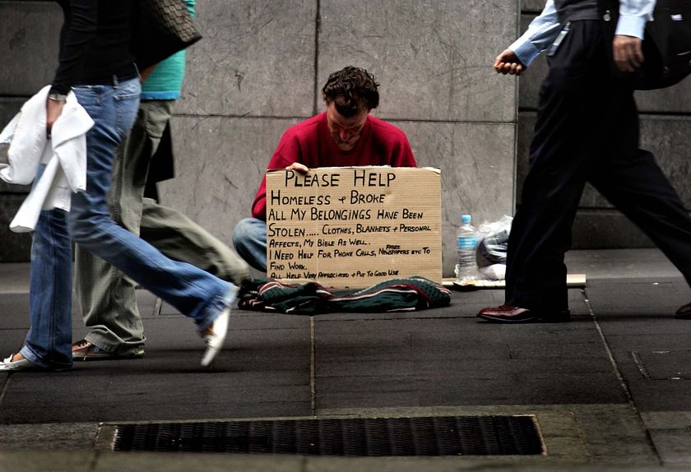
Introduction to Computer Science
Shimon Schocken
IDC Herzliya
Lecture 2-2
Application Example: Gambling
the dream
the dream
the reality
Notes:
36

Slide 37

Gambler's ruin
The game: In each coin flip you either win $1, or lose $1. A gambler starts the game with $500, with the goal of reaching $2,500. What are the chances to reach this goal?

Slide 38
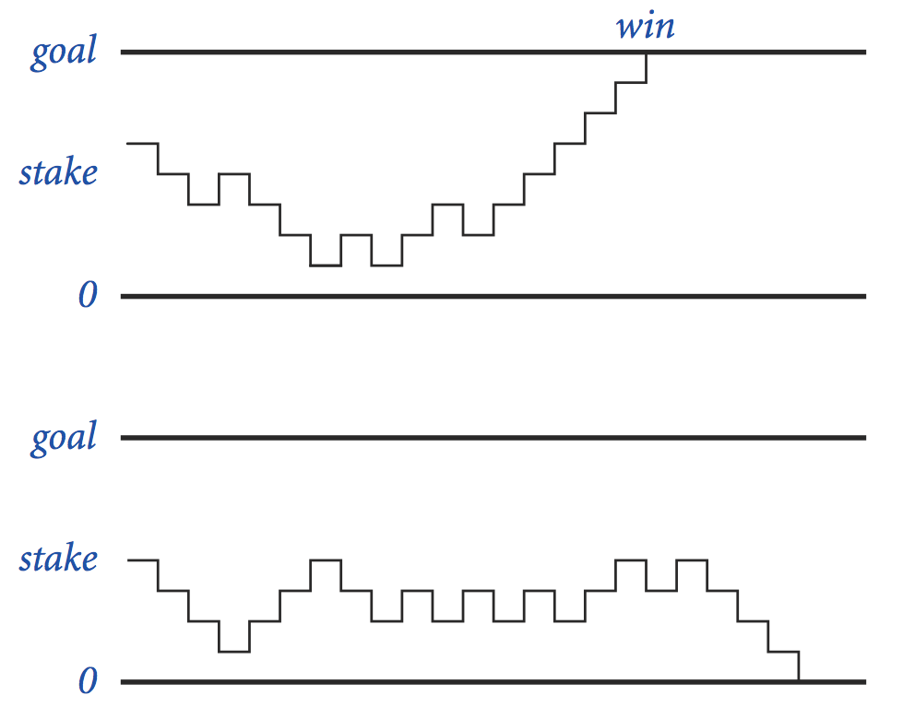
Gambler's ruin
The game: In each coin flip you either win $1, or lose $1. A gambler starts the game with $500, with the goal of reaching $2,500. What are the chances to reach this goal?
Formally: a gambler starts the game with cash = start dollars, and a goal; He plays $1 bets until cash == 0 (loss) or cash == goal (win)
start
winning scenario
start
losing
scenario

Slide 39
Gambler's ruin
The game: In each coin flip you either win $1, or lose $1. A gambler starts the game with $500, with the goal of reaching $2,500. What are the chances to reach this goal?
Formally: a gambler starts the game with cash = start dollars, and a goal; He plays $1 bets until cash == 0 (loss) or cash == goal (win)
Statistics of interest
What is the probability of reaching the goal?
How many flips, on average, until a game ends?
Analysis strategy
Flip a coin and see what happens
Repeat many times
Compute statistics
start
winning scenario
start
losing
scenario
Monte Carlo simulation:
a method for generating numbers pseudo-randomly, and computing statistics on them; Widely used in science, engineering, and gaming.

Slide 40
Gambling simulation
start
goal
T
% java Gambler 500 2500 1000
percentage of winning games: 20%
average number of flips in a game: 1037755
% java Gambler 500 2500 1000
percentage of winning games: 21%
average number of flips in a game: 1039952
% java Gambler 500 2500 1000
percentage of winning games: 19%
average number of flips in a game: 966067
T:
Number of times we play the game (run the simulation);
In each game we either win (cash == goal), or lose (cash == 0)
Note
If T is large, the program can take a long time to run (minutes):
We are simulating 1,000 games, each involving an average of a million coin flips.

Slide 41
Gambling simulation
start
goal
T
% java Gambler 500 2500 1000
percentage of winning games: 20%
average number of flips in a game: 1037755
% java Gambler 500 2500 1000
percentage of winning games: 21%
average number of flips in a game: 1039952
% java Gambler 500 2500 1000
percentage of winning games: 19%
average number of flips in a game: 966067
public class Gambler {
public static void main(String[] args) {
int start = Integer.parseInt(args[0]);
int goal = Integer.parseInt(args[1]);
int T = Integer.parseInt(args[2]);
int nFlips = 0;
int nWins = 0;

Slide 42
Gambling simulation
start
goal
T
% java Gambler 500 2500 1000
percentage of winning games: 20%
average number of flips in a game: 1037755
% java Gambler 500 2500 1000
percentage of winning games: 21%
average number of flips in a game: 1039952
% java Gambler 500 2500 1000
percentage of winning games: 19%
average number of flips in a game: 966067
public class Gambler {
public static void main(String[] args) {
int start = Integer.parseInt(args[0]);
int goal = Integer.parseInt(args[1]);
int T = Integer.parseInt(args[2]);
int nFlips = 0;
int nWins = 0;
// repeats the experiment T times
for (int t = 0; t < T; t++) {
// runs one experiment
int cash = start;
while ((cash > 0) && (cash < goal)) {
// flips coin and update cash situation
if (Math.random() < 0.5) cash++;
else cash--;
nFlips++;
}
if (cash == goal) {
nWins++;
}
} // loops back to start a new game
System.out.println("percentage of winning games: " + 100 * nWins / T + "%");
System.out.println("average number of flips in a game: " + nFlips / T); }
}

Slide 43
Gambling simulation
start
goal
T
% java Gambler 500 2500 1000
percentage of winning games: 20%
average number of flips in a game: 1037755
% java Gambler 500 2500 1000
percentage of winning games: 21%
average number of flips in a game: 1039952
% java Gambler 500 2500 1000
percentage of winning games: 19%
average number of flips in a game: 966067
Results from probability theory:
Probability of winning = start / goal
Expected number of flips =
start × (goal – start)
Observations
Theory and experiment lead to the same conclusion
So... why simulate?
We use simulation to validate theory, or to help reach the theory
We use simulation for generating pseudo-random events from a given model
Examples: research, training, investing, playing, etc.
In many cases a theoretical model is not available, and simulation is the only way to generate data and compute statistics.

Slide 44
Introduction to Computer Science
Reichman University
Lecture 2-2
Conditional and Iterative Processing
Part II
Notes:
44

